Slide 1
Copy of 2.1.1.6.crd_cnt_basic_example_slide_template

Slide 2
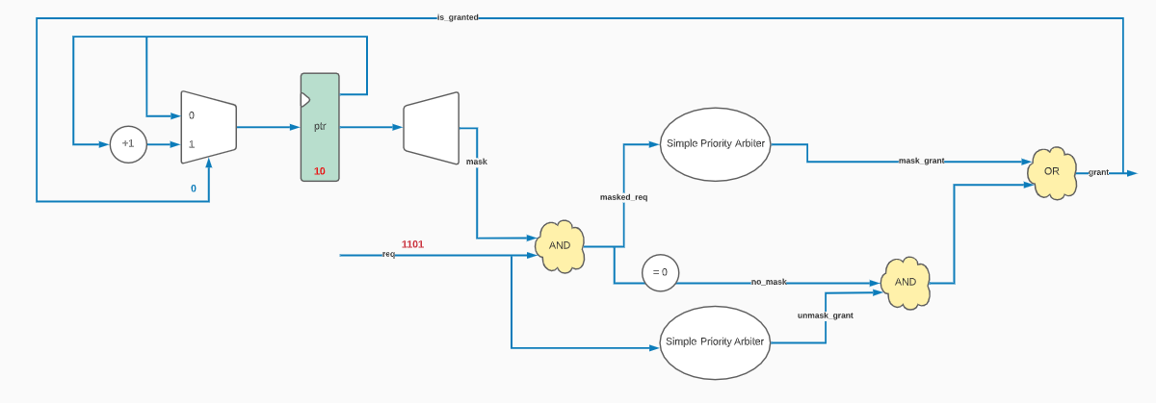
Slide 1 Copy 1

Slide 3
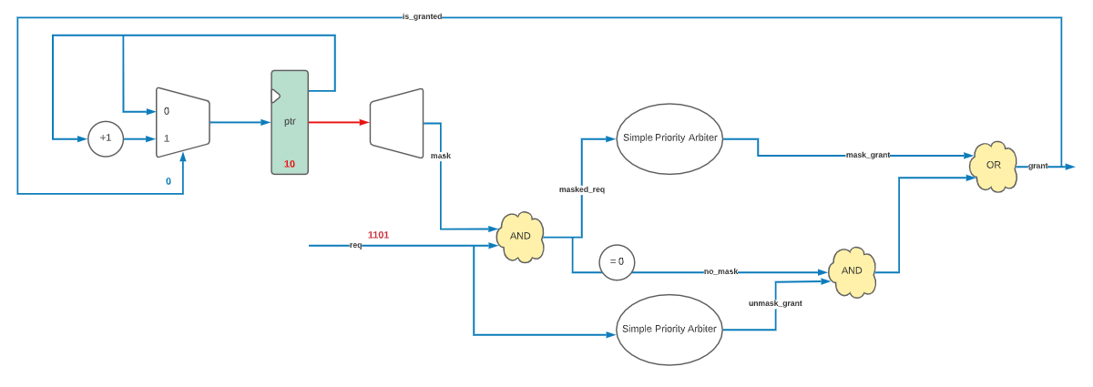
Slide 3

Slide 4
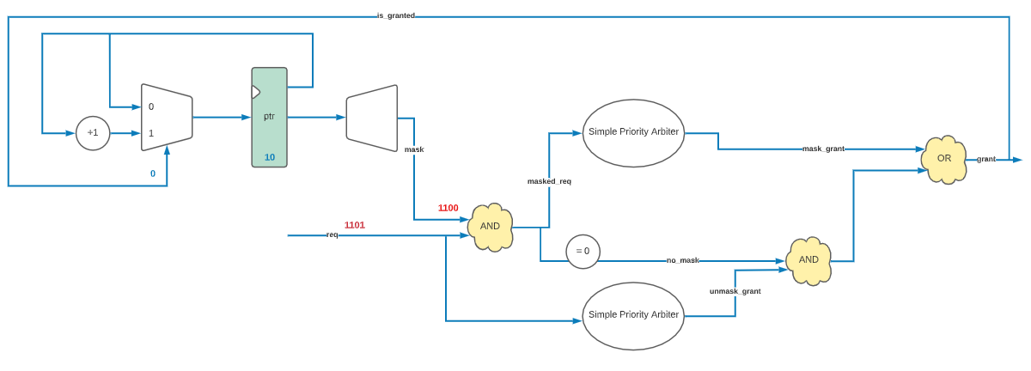
Slide 4

Slide 5
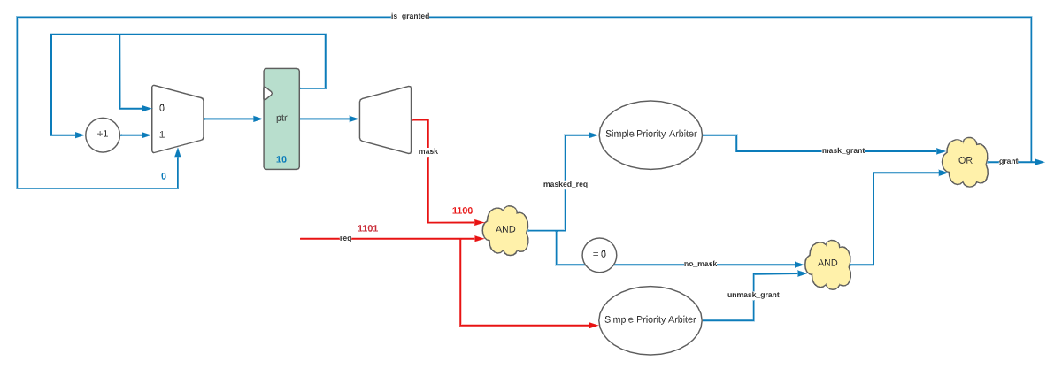
Slide 5

Slide 6
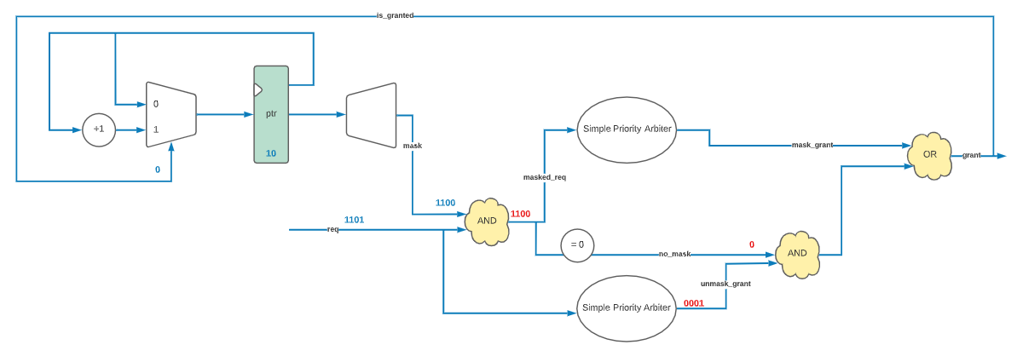
Slide 6

Slide 7
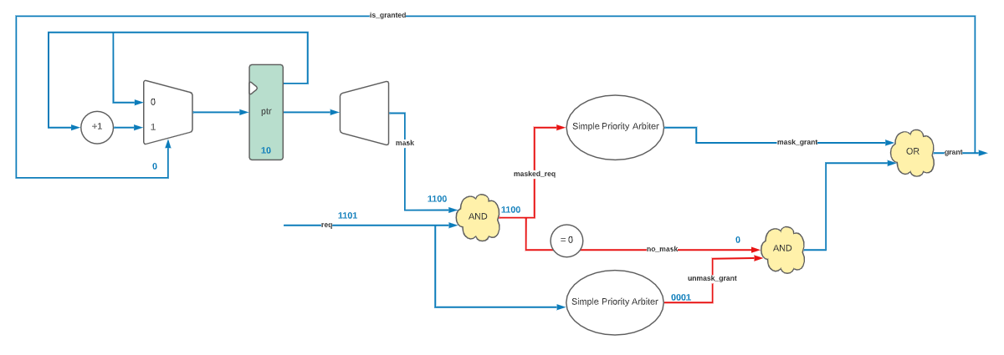
Slide 7

Slide 8
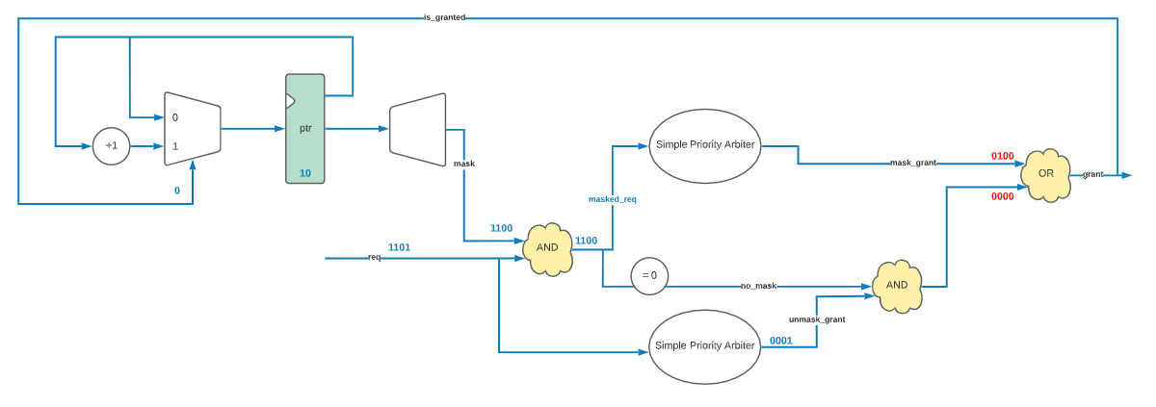
Slide 8

Slide 9
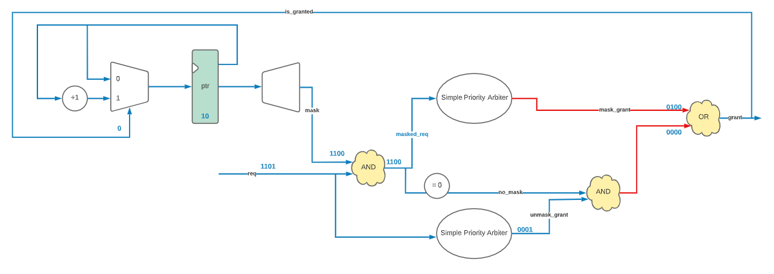
Slide 9

Slide 10
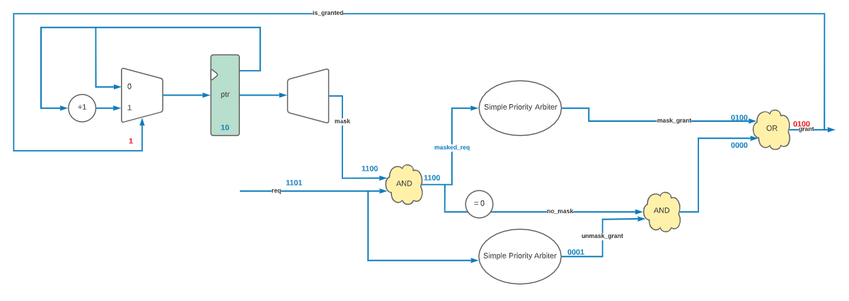
Slide 10

Slide 11
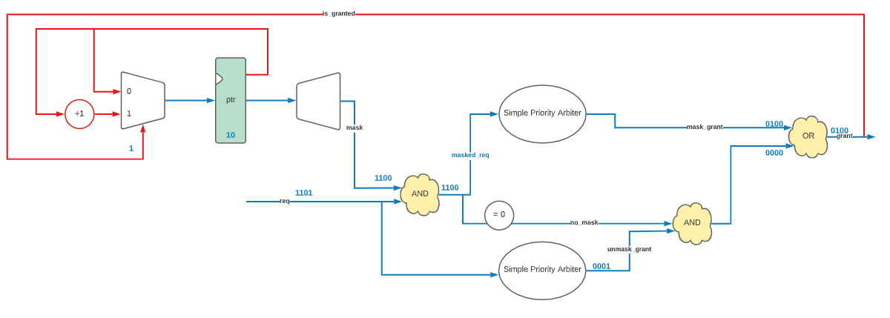
Slide 11

Slide 12
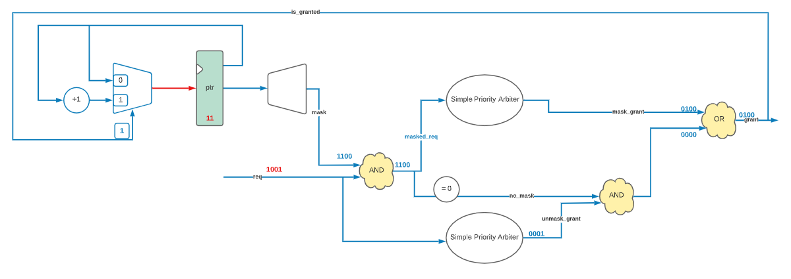
Slide 12

